Slide 1


Robin App
User manual - English
Department of Child and Adolescent Psychiatry and Psychotherapy

Slide 2
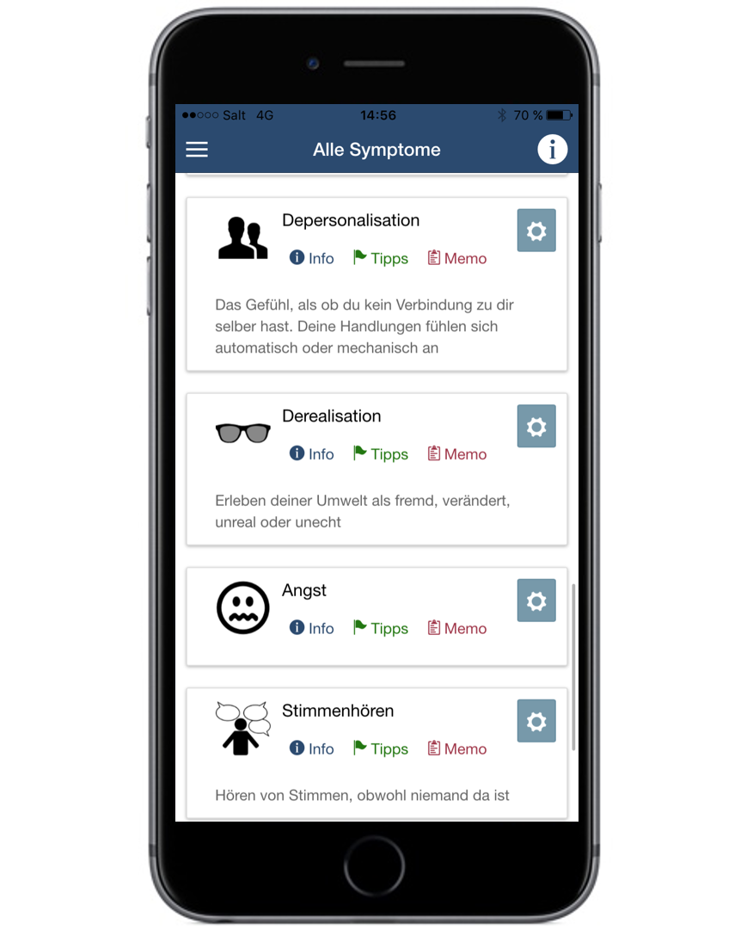
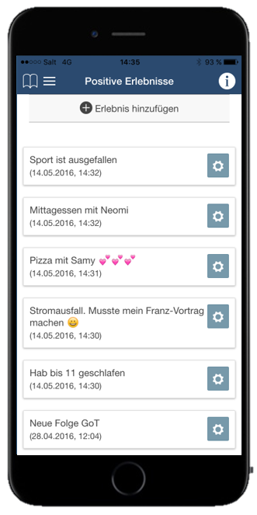
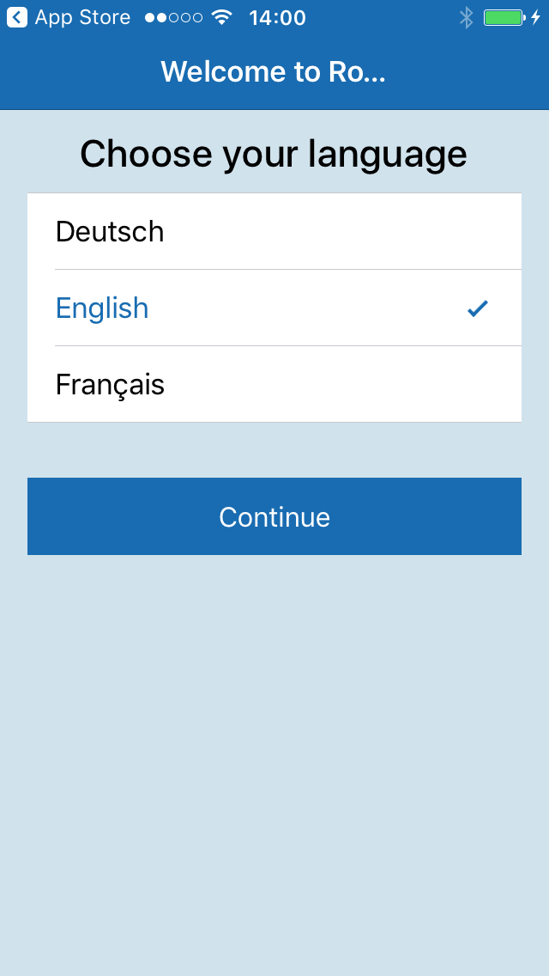
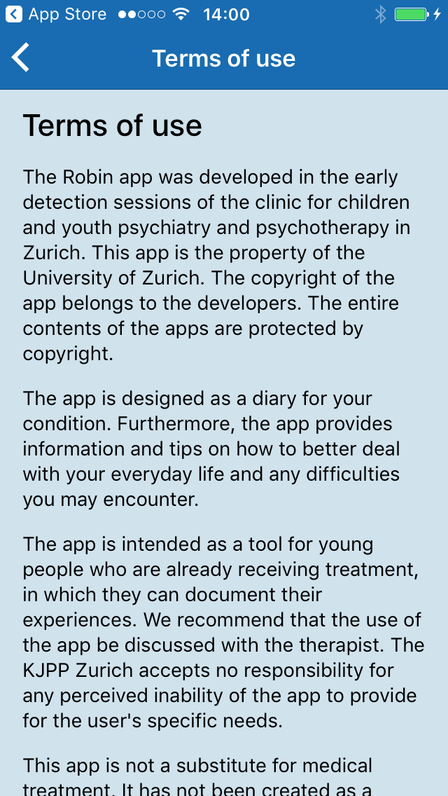
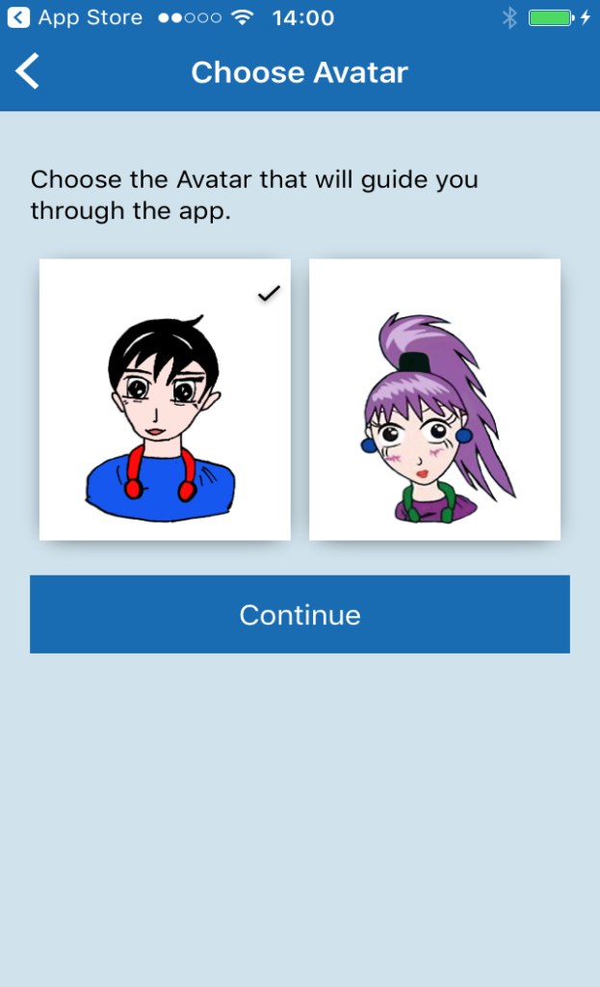
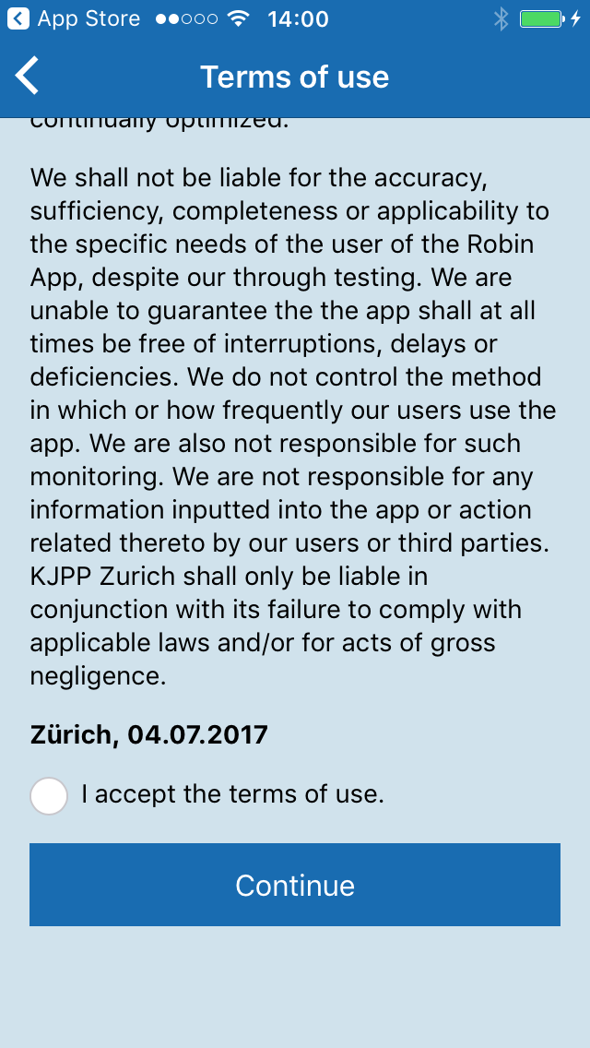
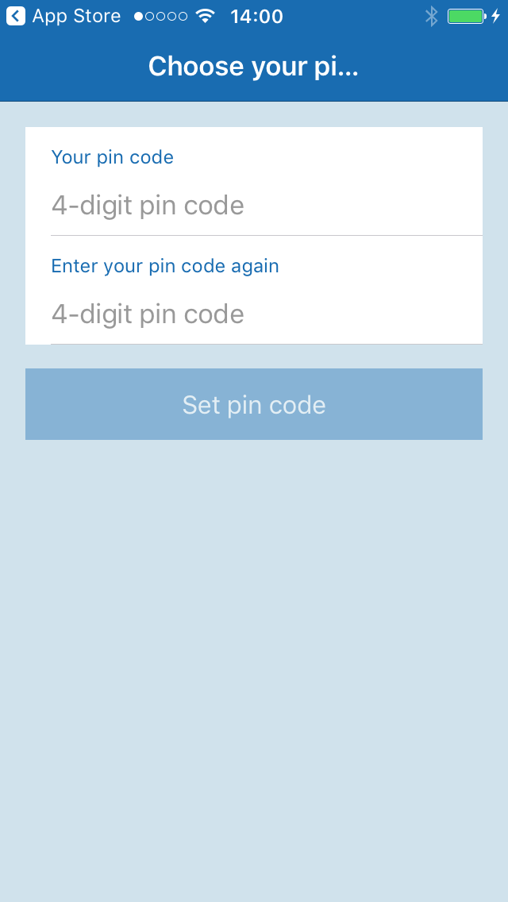
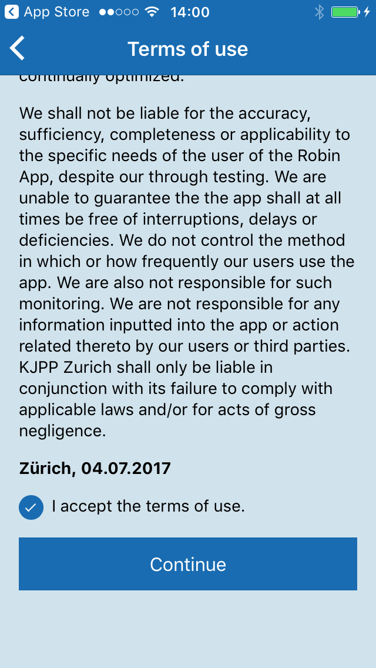
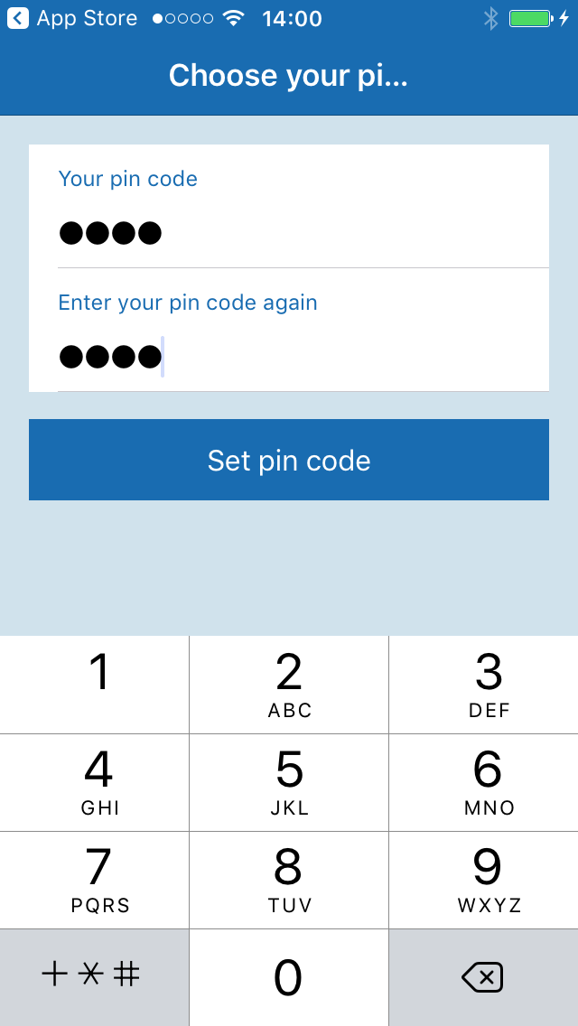

In the beginning you can choose from different settings and also protect your data with a password.

Slide 3
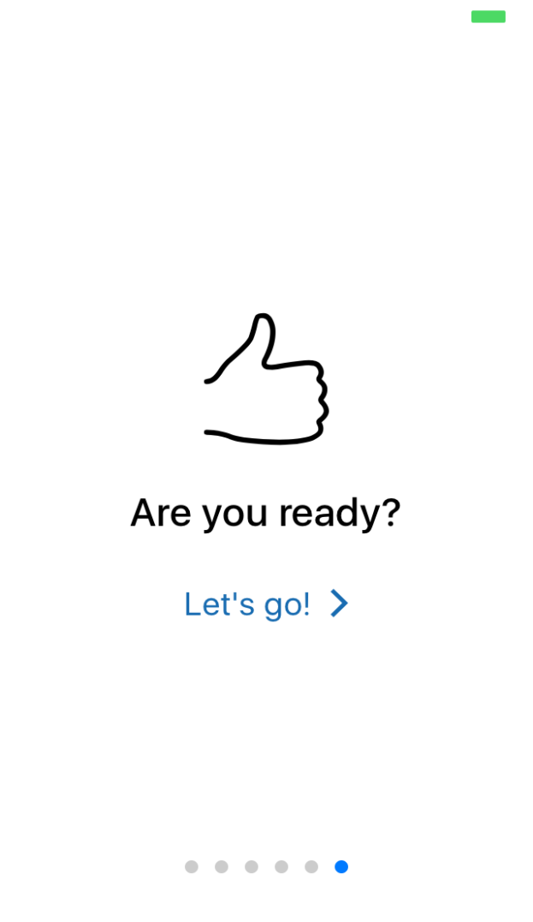
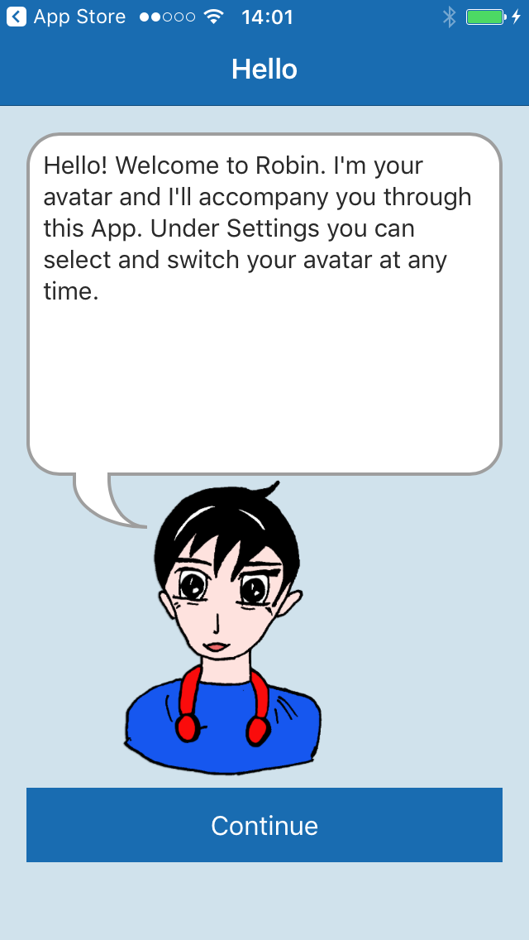
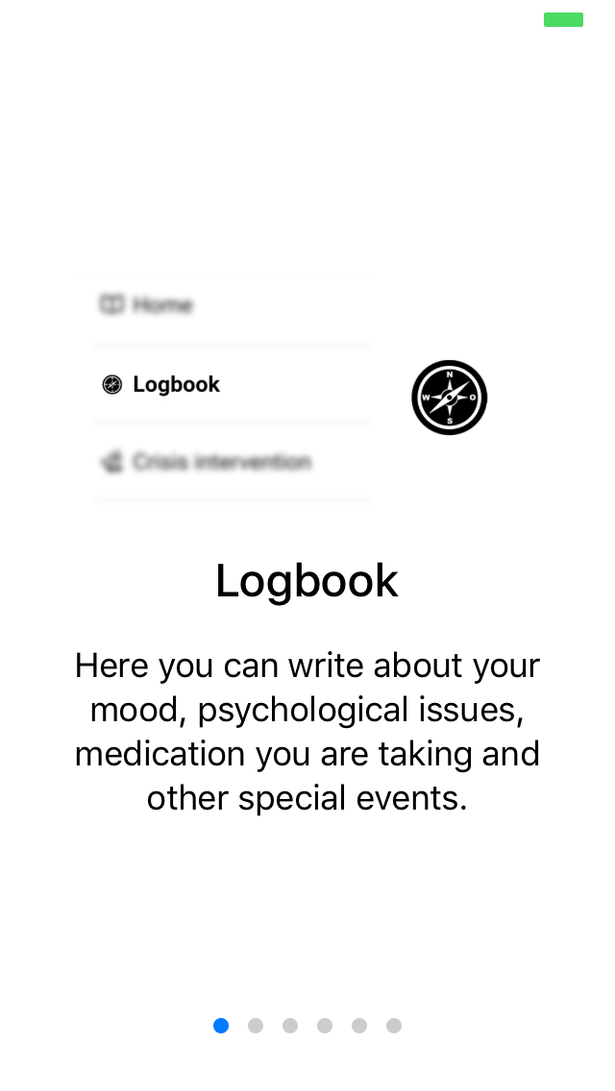
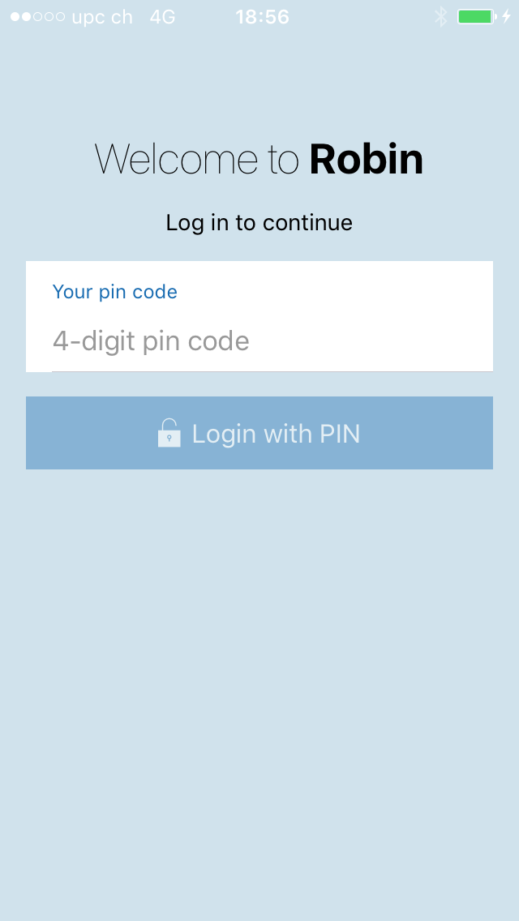
Here you get first information on the different chapters of the app.
Each time you start your app, you will be asked to enter your pin code.

Slide 4
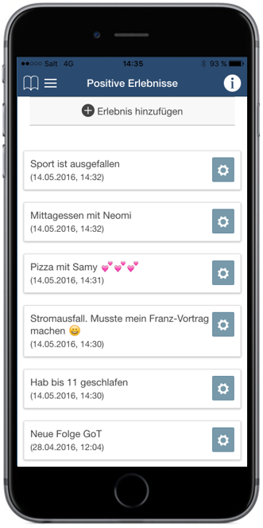
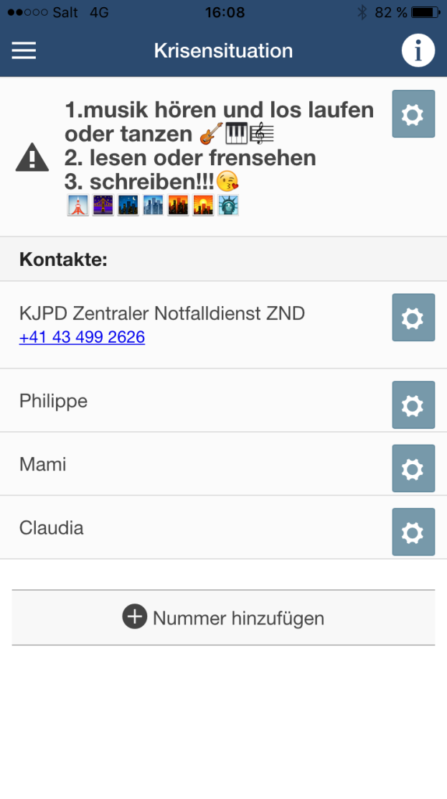
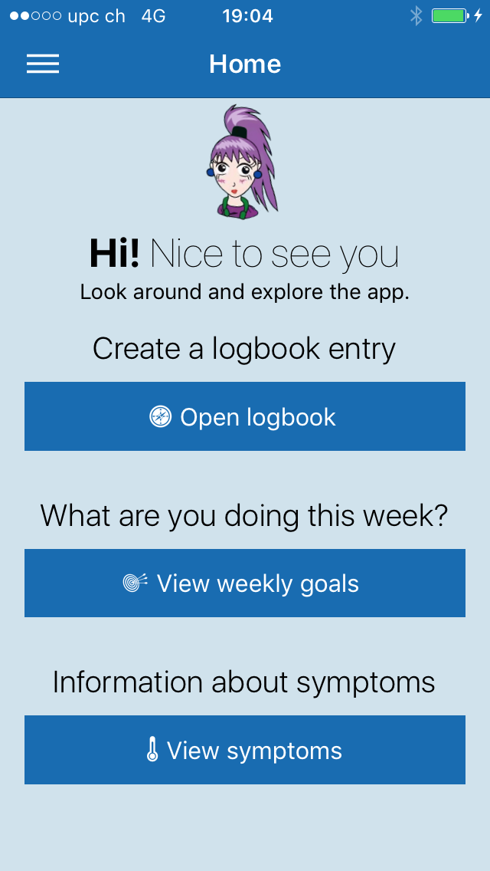
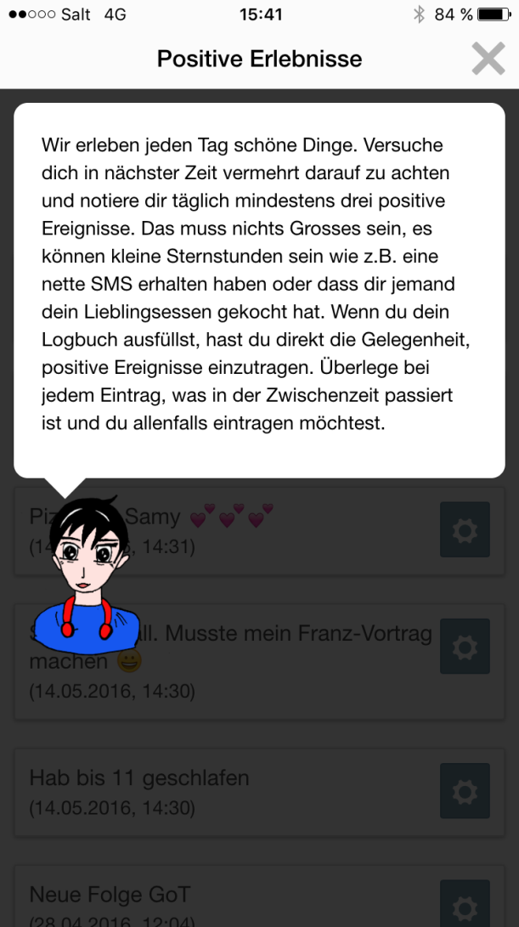
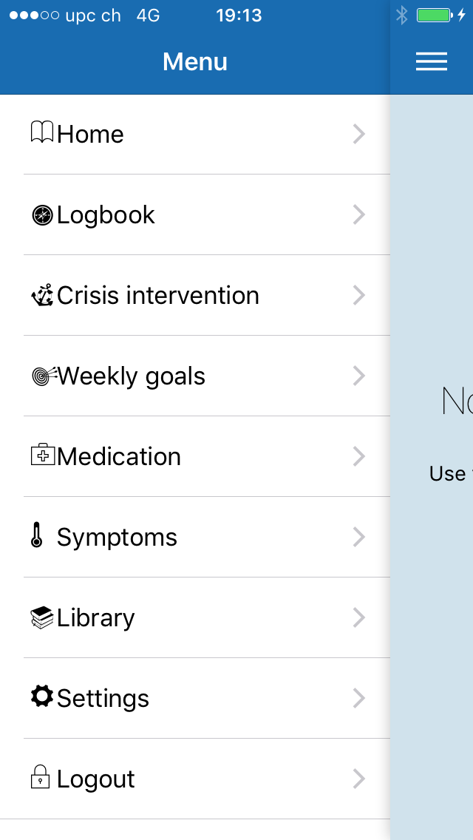
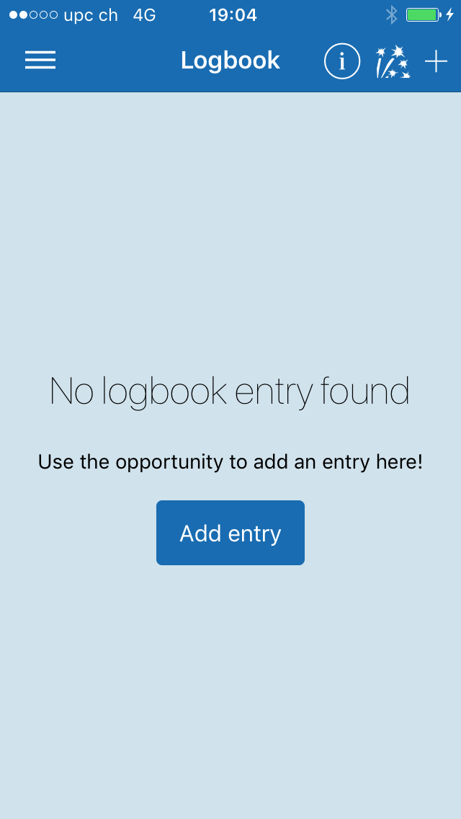
With the home button you always get back to the front page.

Slide 5

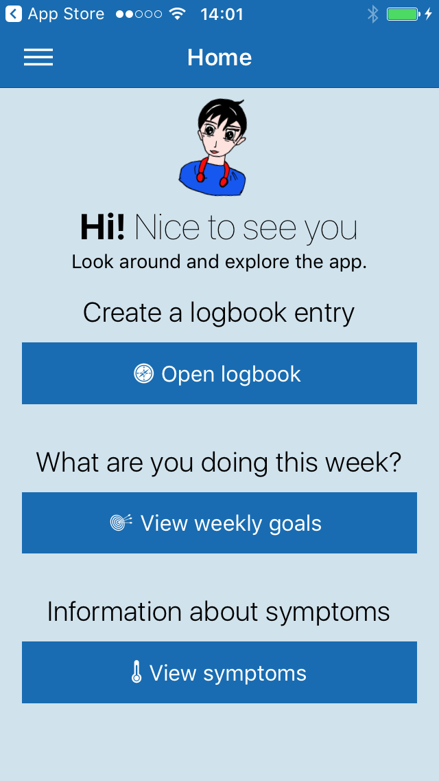
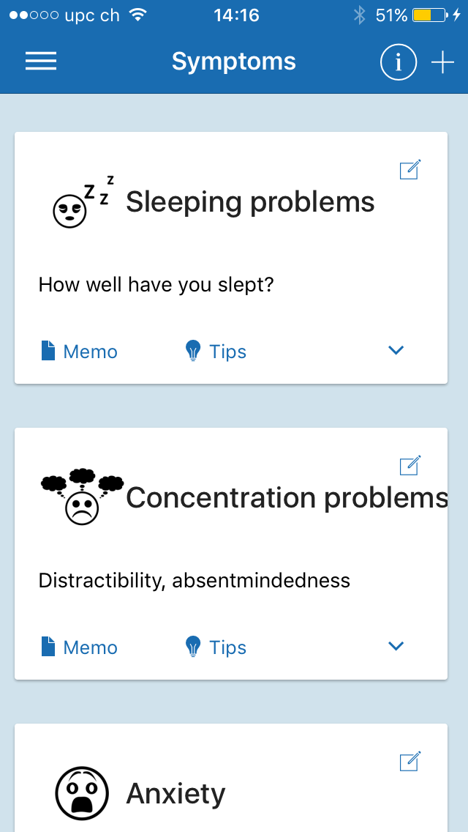
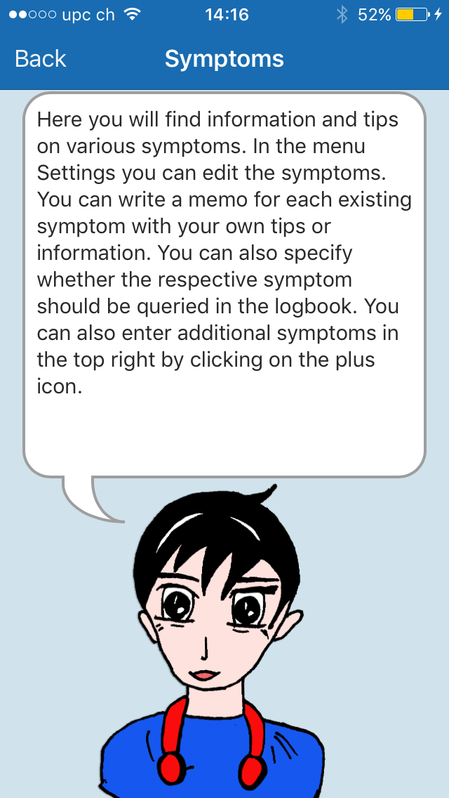


Slide 6
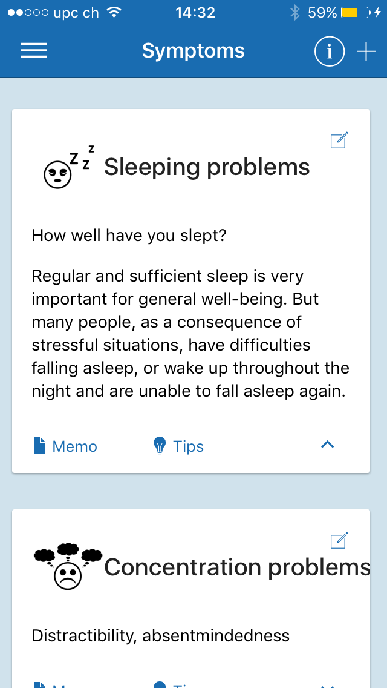
Here you can find helpful background information on the different symptoms.

Slide 7
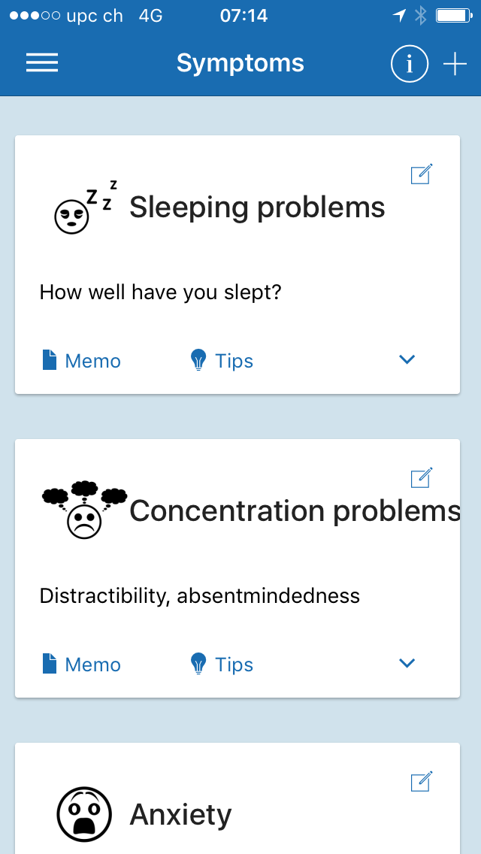
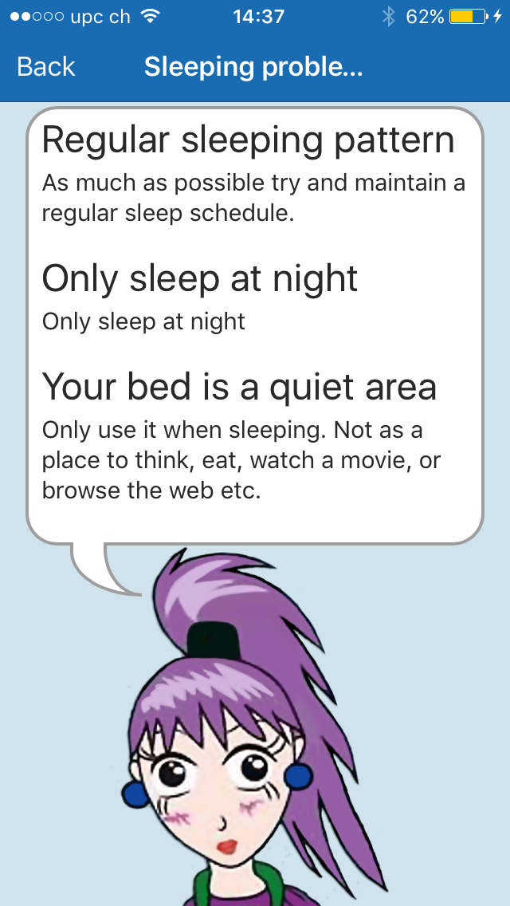
Here you can find helpful ways and strategies to cope better with the symptoms.

Slide 8
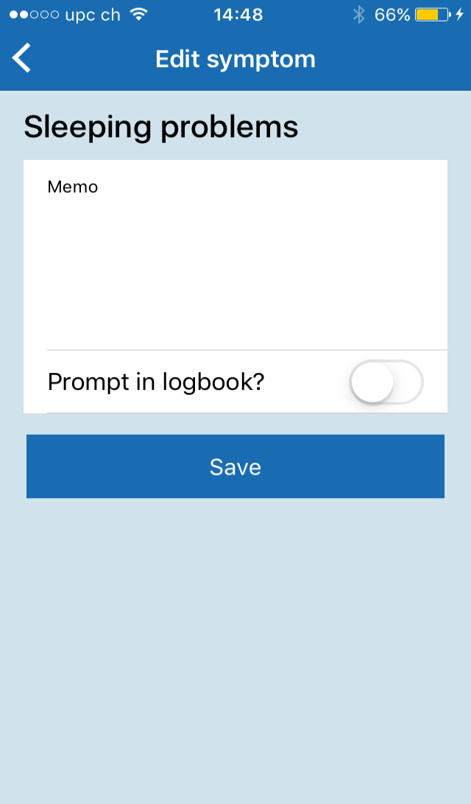
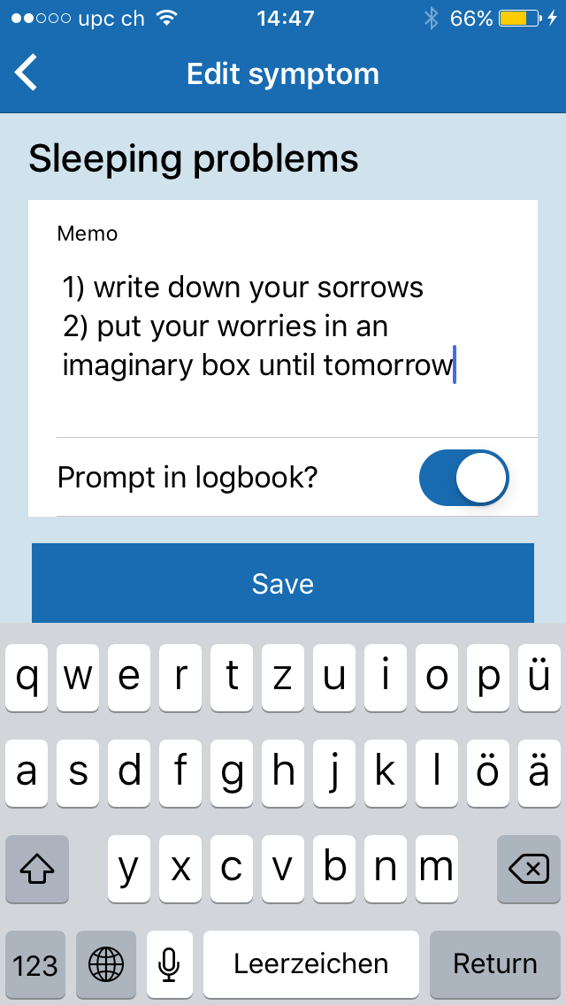
If your own coping strategies aren’t already listed in the tips you can write them down here.

Slide 9
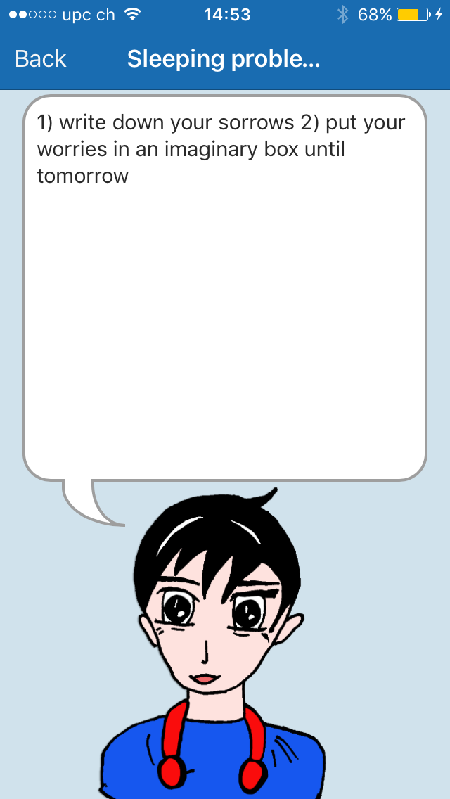
Under Memo you can find your own ideas and strategies on dealing with the symptoms.

Slide 10
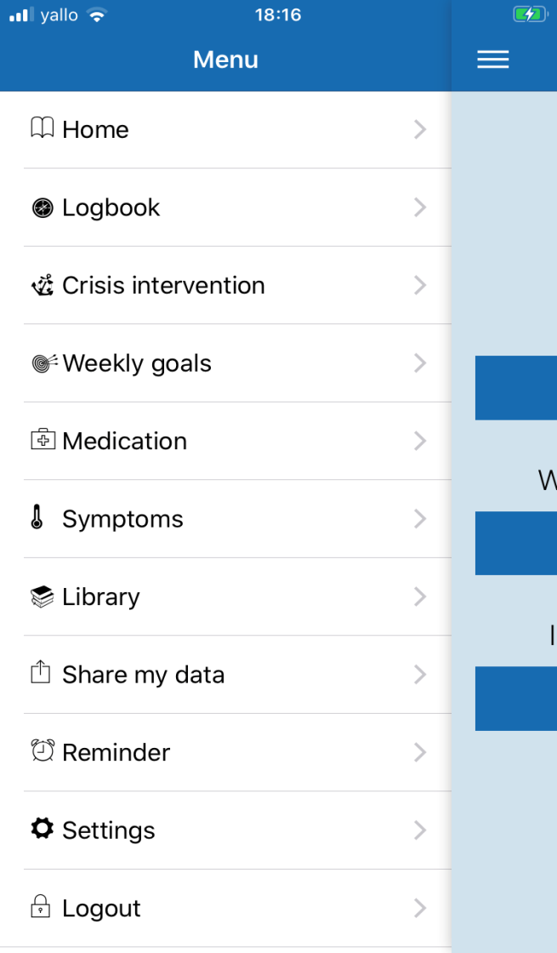
You also can get to the symptoms through the menu.
You can add further missing symptoms with the plus button.

Slide 11
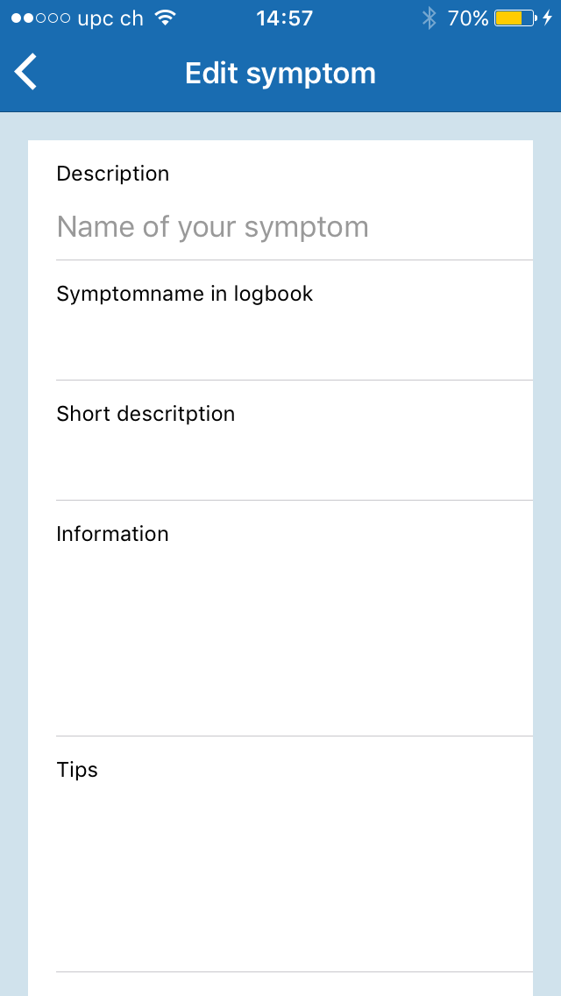
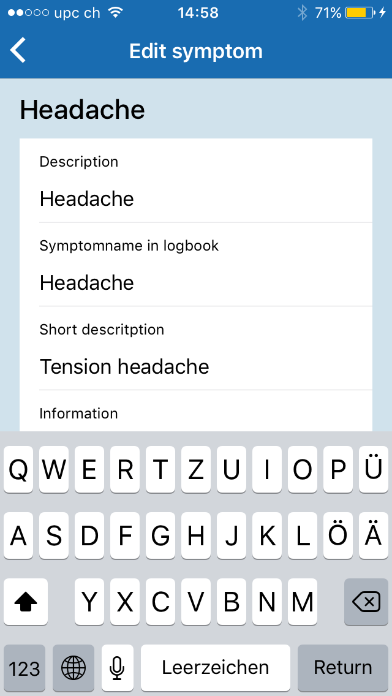
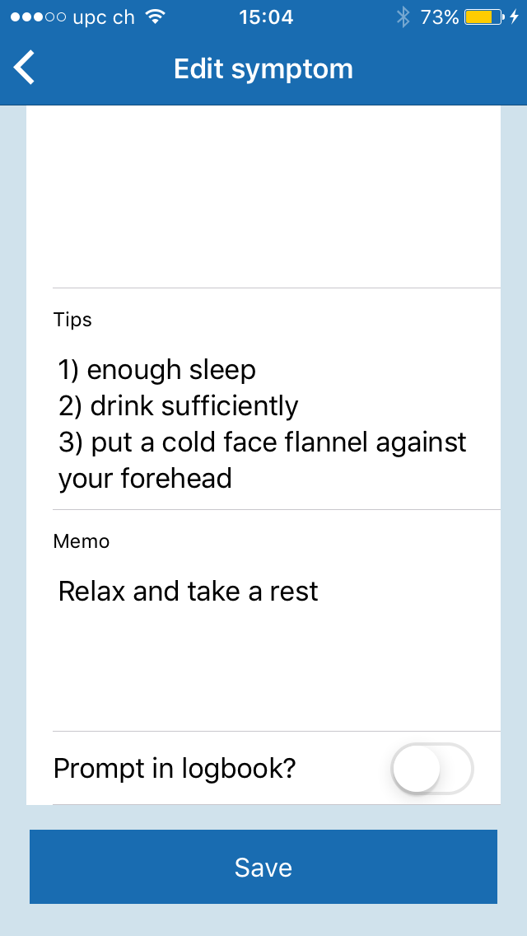
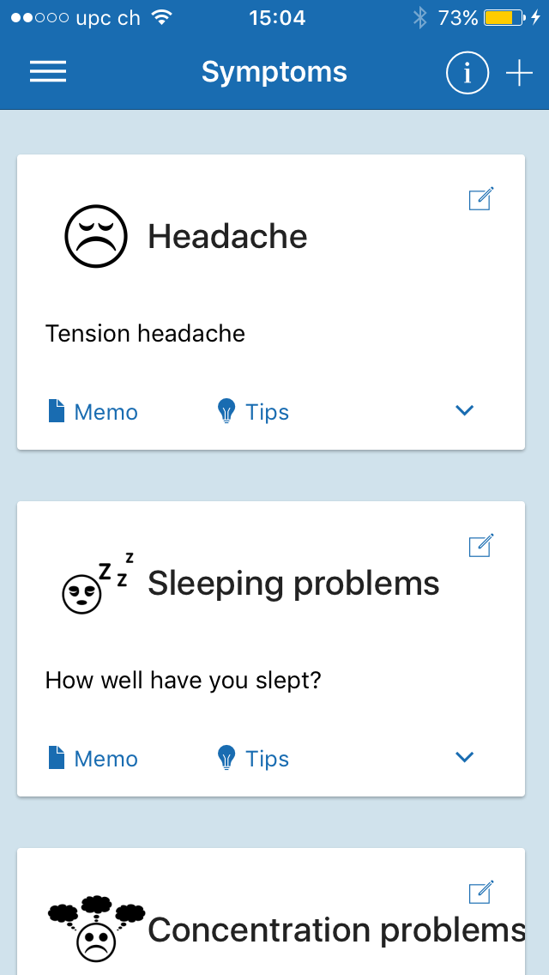

Slide 12
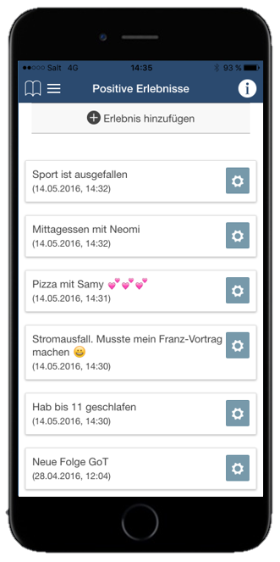

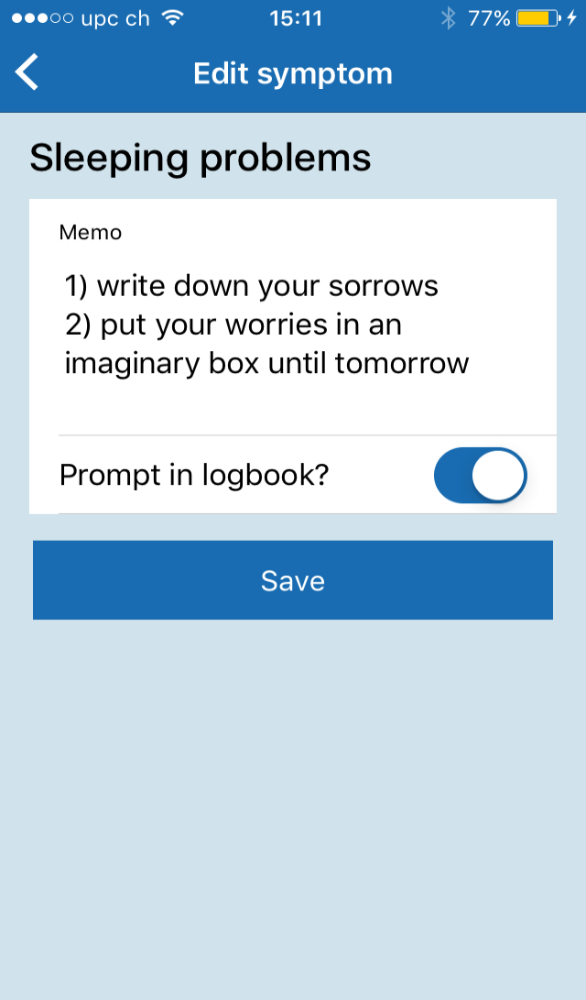
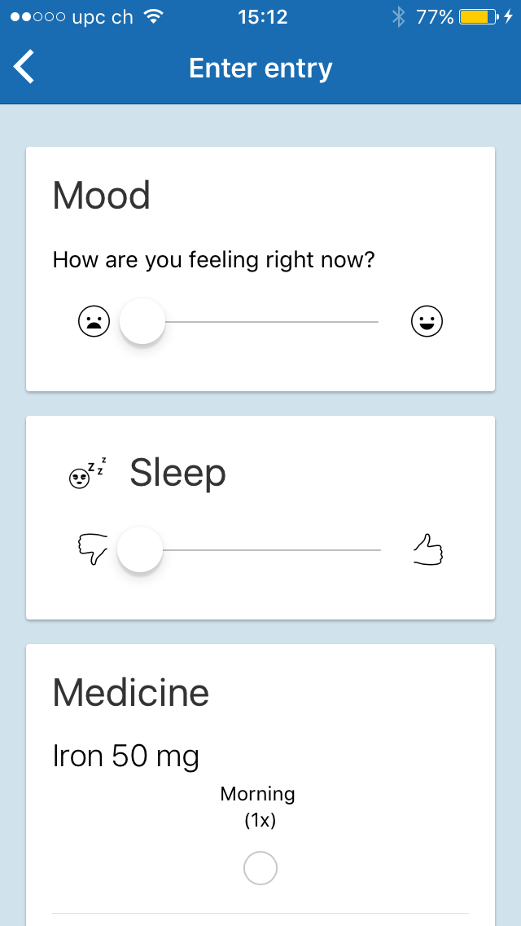

For important symptoms you can have the app prompt you so you remember your coping strategies

Slide 13
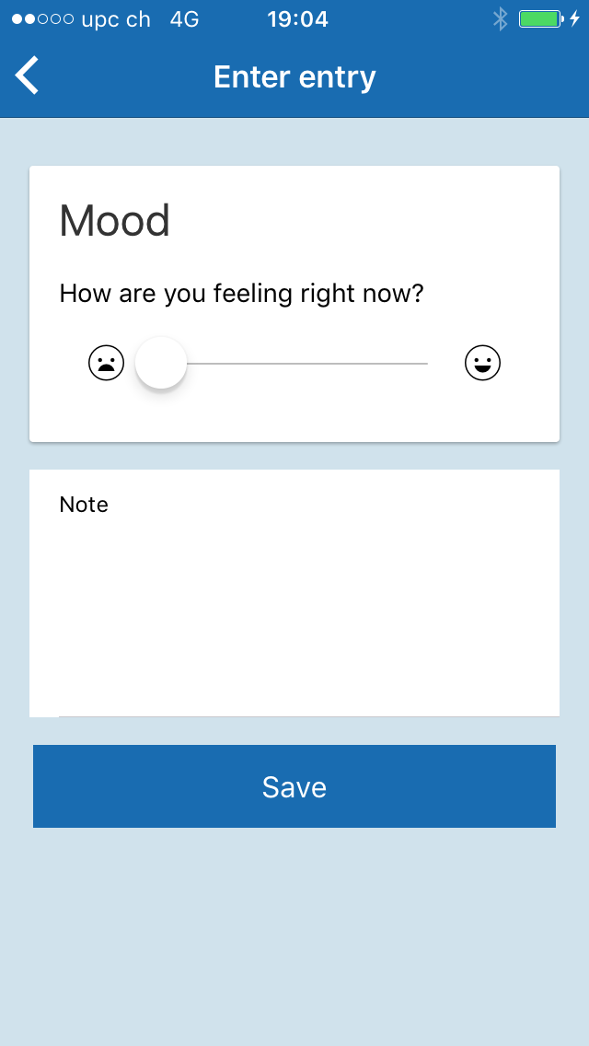
Logbook: Here you can write about your mood, psychological issues, medication you are taking and other special events

Slide 14

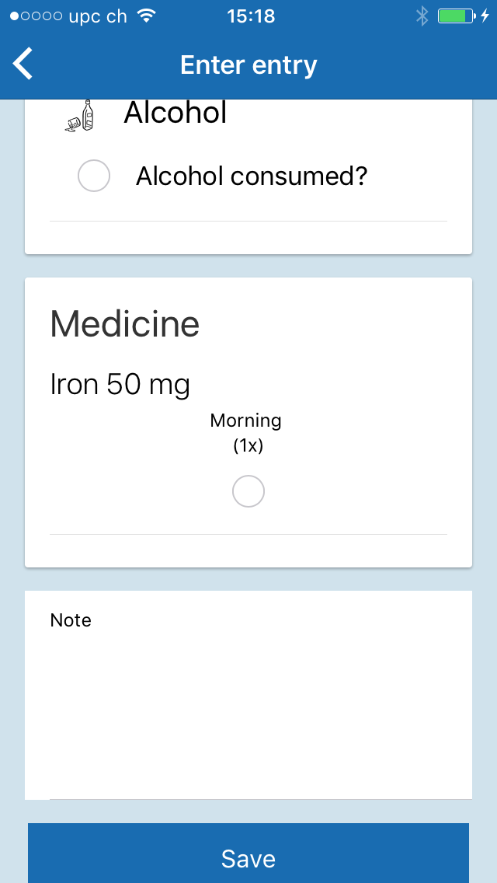

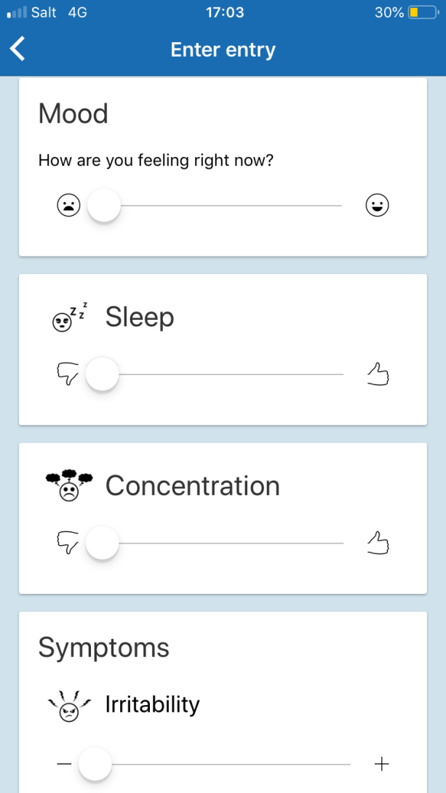
Zuerst wird immer deine aktuelle Stimmung abgefragt.
Du kannst im Logbuch festhalten, ob du bestimmte Substanzen konsumiert hast.
Unter Medikamente kannst du angeben, ob du das Medikament eingenommen hast. Falls du später unsicher bist, kannst du im Logbuch nachschauen, ob du das Medikament bereits eingenommen hast.
Danach kannst du angeben, wie gut du geschlafen hast und wie gut du dich im Moment konzentrieren kannst
Unter Symptome werden die
einzelnen Symptome, die du ausgesucht hast abgefragt.
Unter Bemerkungen kannst du aktuelle Ereignisse, die evtl. einen Einfluss auf deine Stimmung oder deine Symptome haben, notieren.

Slide 15
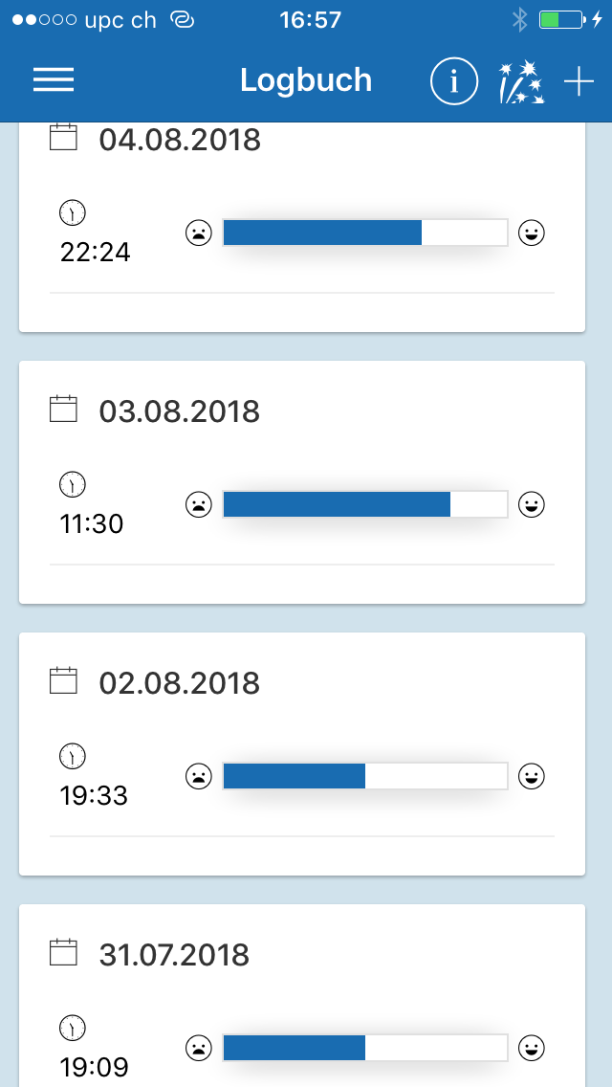
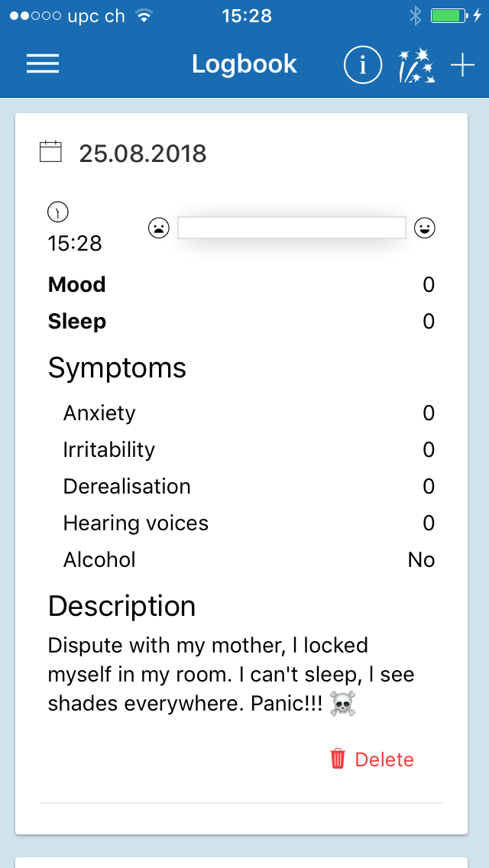
Here is an overview of all your logbook entries.
When clicking on one specific logbook entry, you’ll find your summary of the day.

Slide 16
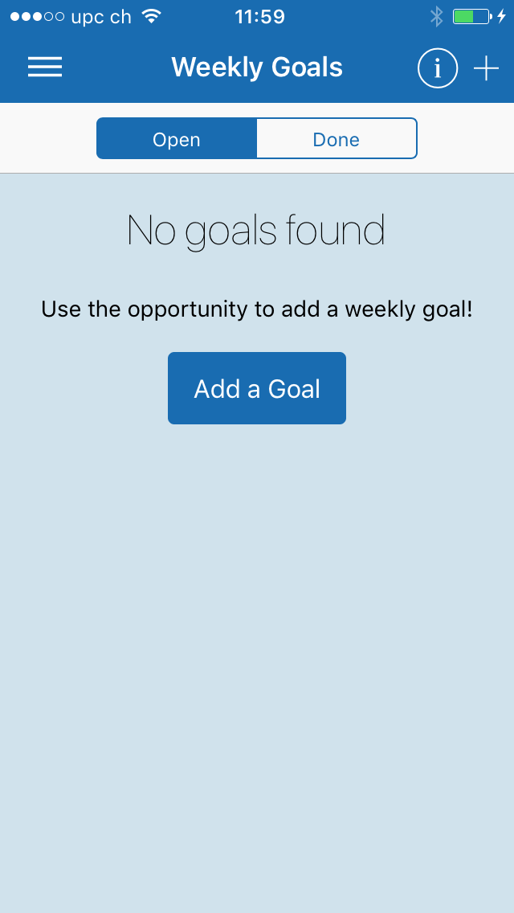
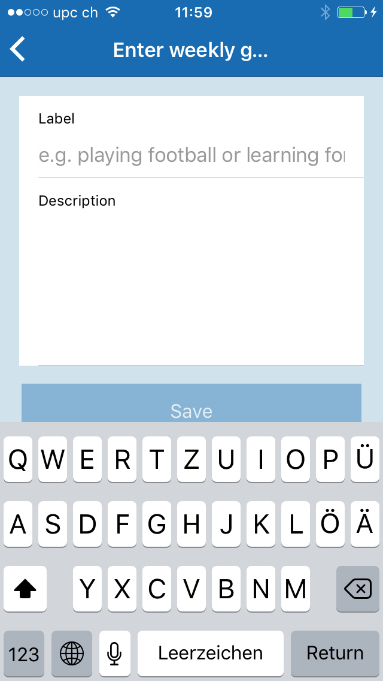
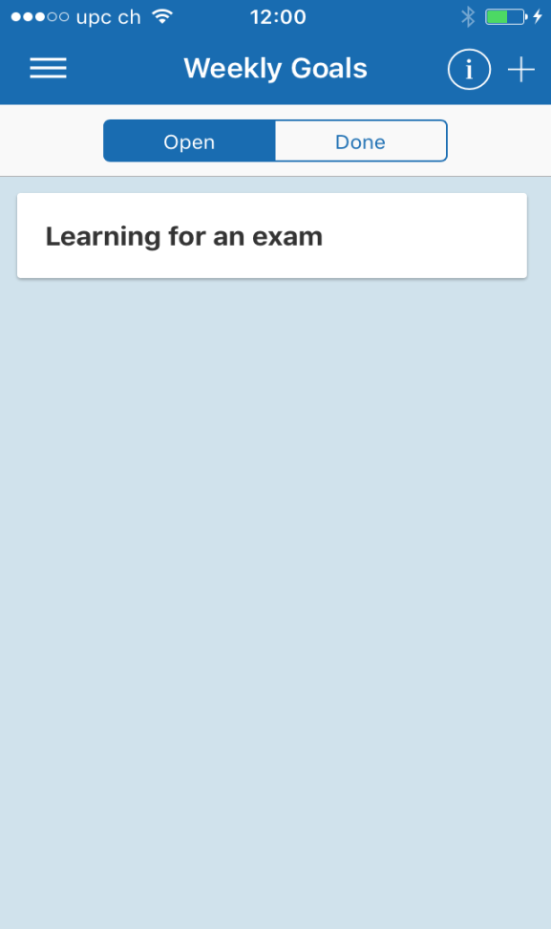
Weekly goals: Here you can create a list of goals you’d like to achieve each week.

Slide 17

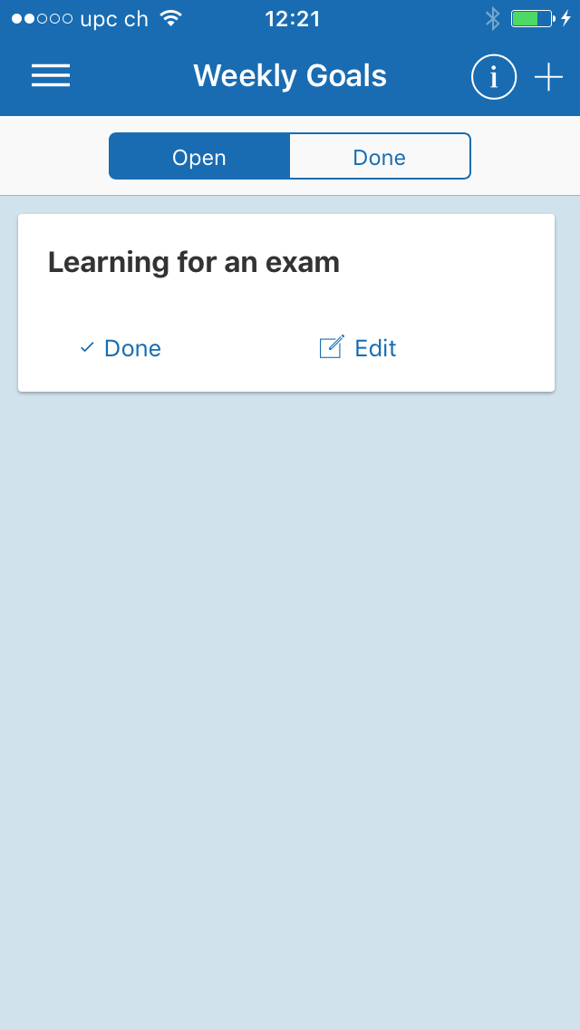
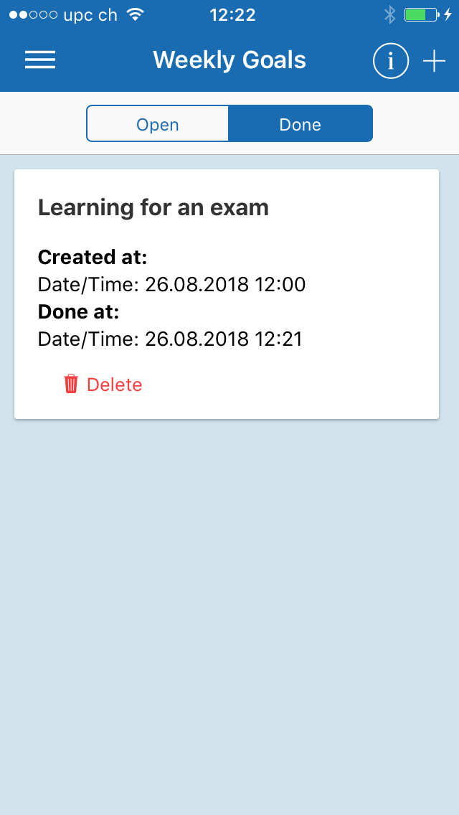
Under «done» you can find your goals marked as done.

Slide 18

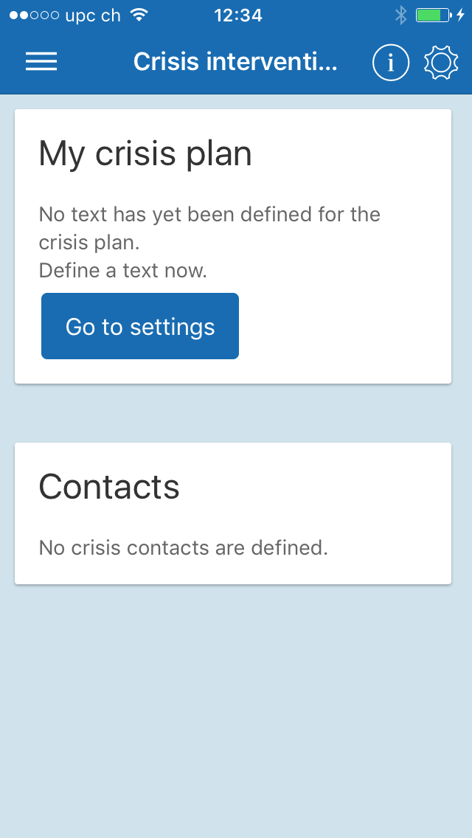
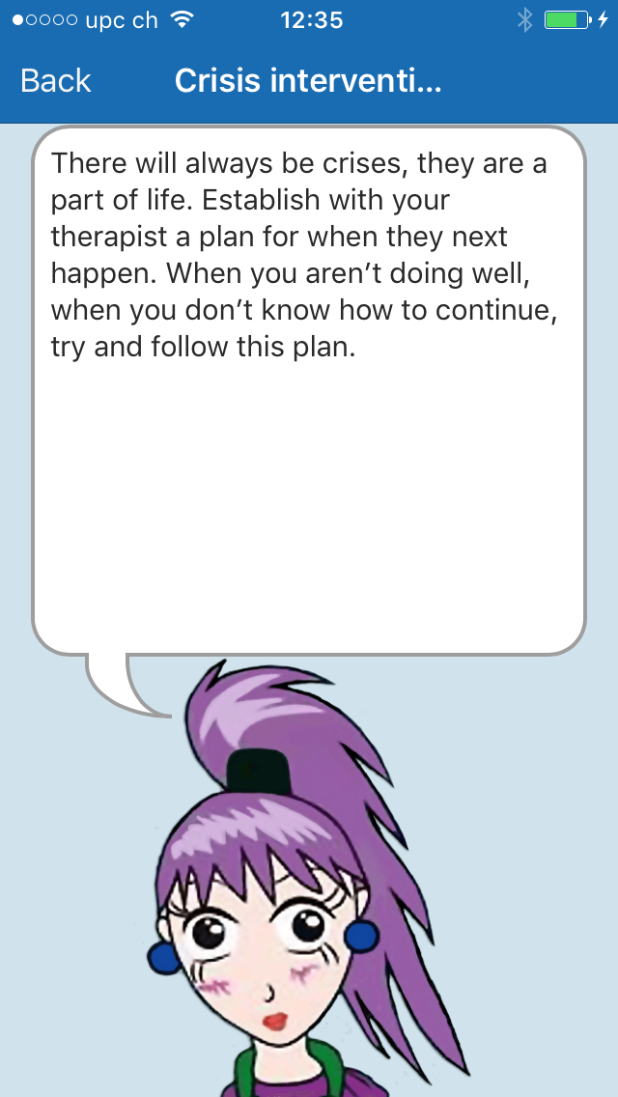

Slide 19
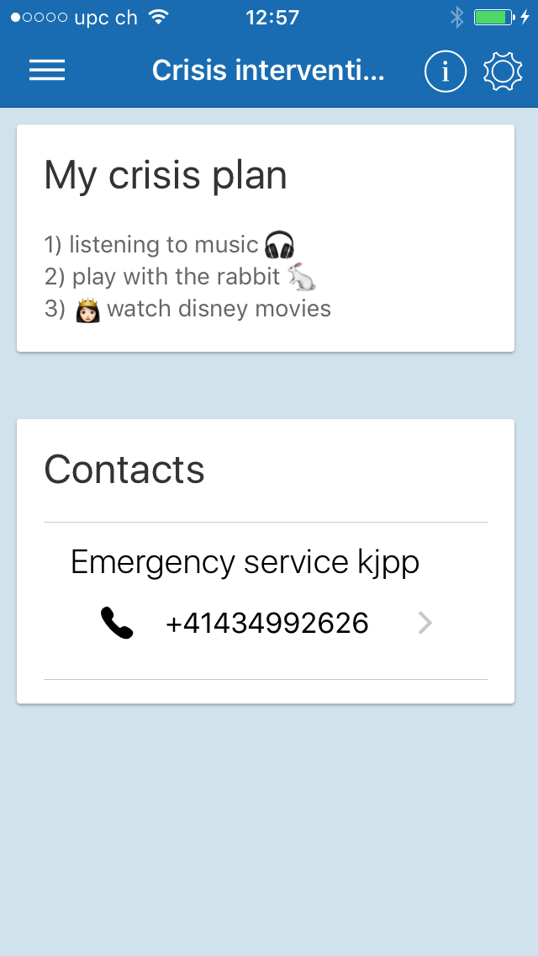
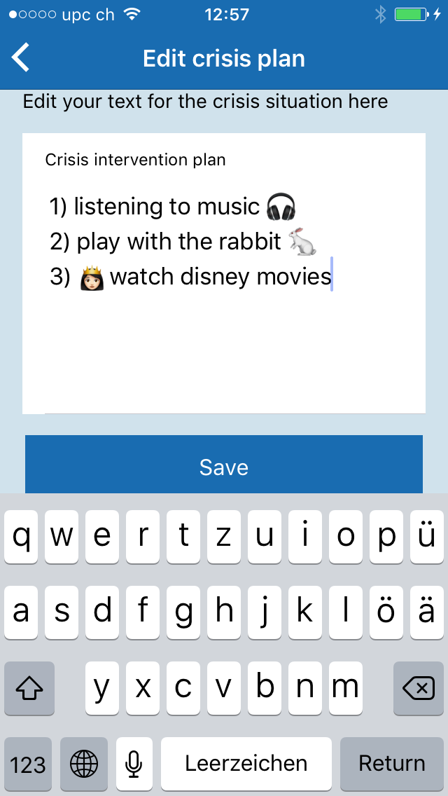



Here you can save emergency contacts, which are automatically dialed by clicking on them.
Crisis Plan: This is where you can create a plan for what to do in a crisis situation. Having this written down and easily accessible will help you deal with the situation and get well again.

Slide 20




Slide 21





Here you can list your mediation and dosage and why you have to take it. You can also determine when to take it.

Slide 22




Here you can edit your medication entry.
Here you can activate the reminder in the logbook. So if in doubt you can make sure that you have already taken your medication.

Slide 23






Library: In this section you can get help dealing with your every day problems. You can create a list of what your strengths are and ask your friends to complete the list.

Slide 24







The library is also a place where you can find suggestions for positive and fun activities you can do to help brighten up your mood and day. You can also add your own ideas.

Slide 25




You also have space for a gratitude diary in which you can write about positive events and experiences that happened to you. You can open and read these at any time, and if you’re finding things tough and are feeling down they can help you feel better again

Slide 26





With the function "Share my data" the data can be shared with the therapist.
Choose a secure password and share it with your therapist the next time you see him/her.

Slide 27






Under Reminder, you can set reminders for your logbook entries or for taking your medication.

